Slide 1
Introduction to Hadoop and MapReduce
Elsayed Hemayed
The original slides are from EMC, IBM, and Prof. Dong Wang.

Slide 2
Overview
Why Hadoop? Why MapReduce?
What is Hadoop? What is MapReduce?
MapReduce Examples
A Weather Dataset
Hadoop Streaming
Job Output
MapReduce Dataflow

Slide 3
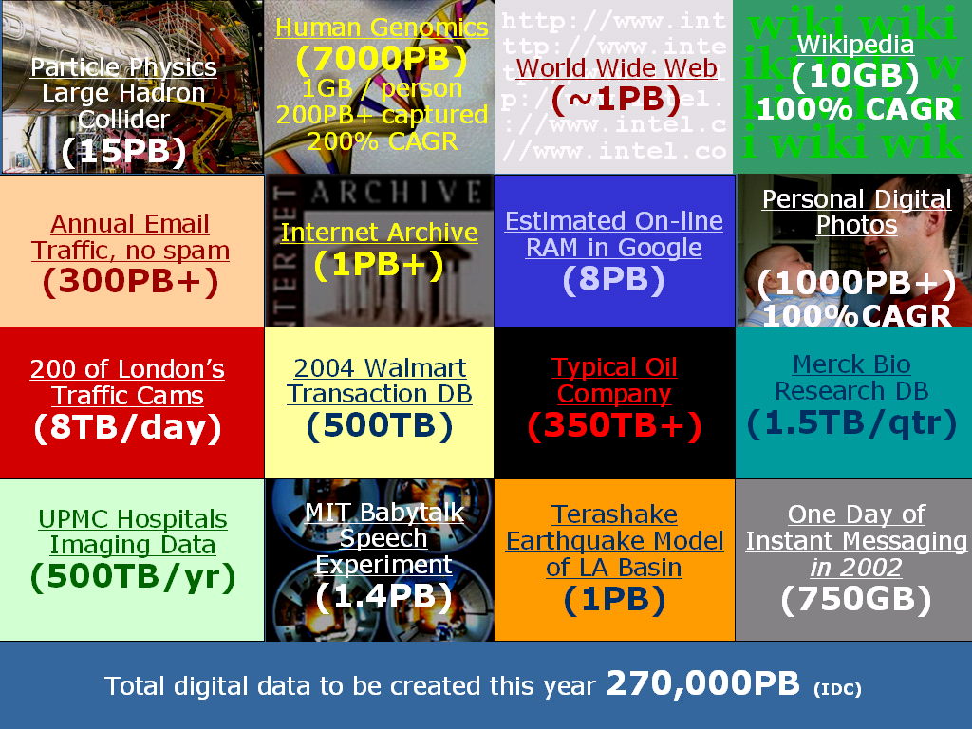
Why Hadoop?
Answer: Big Datasets!
Notes:
Consider the examples of different classes of “big data.” If we are to achieve anything with data of this size, we need a way both to store and access this information such that we can retrieve information in finite time.

Slide 4
What is Big Data
Wikipedia big data
An all-encompassing term for any collection of data sets so large and complex that it becomes difficult to process using on-hand data management tools or traditional data processing applications.

Slide 5
How big is big?
2008: Google processes 20 PB a day
2009: Facebook has 2.5 PB user data + 15 TB /day
2011: Yahoo! has 180-200 PB of data
2012: Facebook ingests 500 TB/day
2013: YouTube 1000 PB video storage; 4 billion views/day
1 PB=10^3 TB=10^6 GB=10^15 B
1 Exabyte = 1000 PB
Zettabyte, Yottabyte …
Notes:
alphabets

Slide 6











Who is generating Big Data?
Social
User Tracking & Engagement
Homeland Security
eCommerce
Financial Services
Real Time Search

Slide 7

That is a lot of data …

Slide 8
What are Key Features of Big Data?
Volume
Velocity
Petabyte scale
Social Media
Sensor
Throughput
Big Data
Variety
4 Vs
Veracity
Structured
Semi-structured
Unstructured
Unclean
Imprecise
Unclear

Slide 9
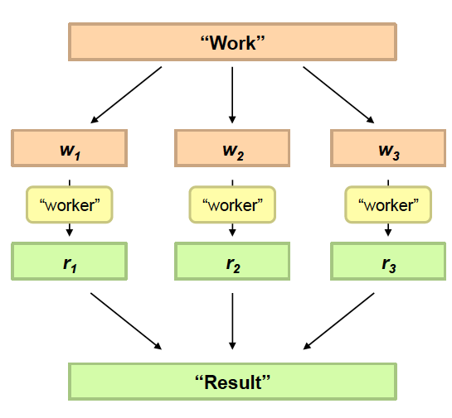
Philosophy to Scale for Big Data? (Divide and Conquer)
Divide Work
Combine Results

Slide 10

Distributed processing is non-trivial
How to assign tasks to different workers in an efficient way?
What happens if tasks fail?
How do workers exchange results?
How to synchronize distributed tasks allocated to different workers?

Slide 11

Big data storage is challenging
Data Volumes are massive
Reliability of Storing PBs of data is challenging
All kinds of failures: Disk/Hardware/Network Failures
Probability of failures simply increase with the number of machines …

Slide 12
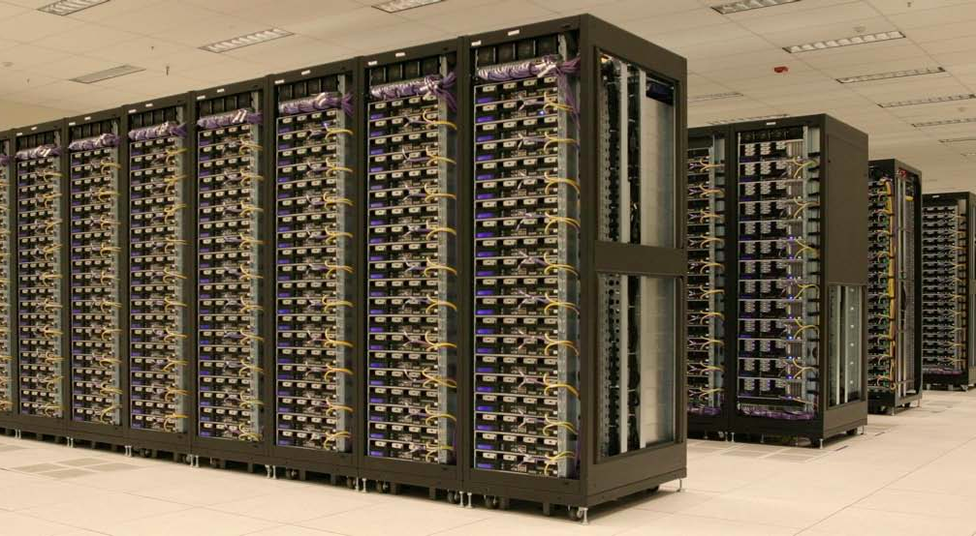
One popular solution: Hadoop
Hadoop Cluster at Yahoo! (Credit: Yahoo)

Slide 13

Hadoop offers
Redundant, Fault-tolerant data storage
Parallel computation framework
Job coordination

Slide 14


Hadoop offers
Redundant, Fault-tolerant data storage
Parallel computation framework
Job coordination
Q: Where file is located?
No longer need to worry about
Q: How to handle failures & data lost?
Q: How to divide computation?
Programmers
Q: How to program for scaling?

Slide 15



A real world example of New York Times
Goal: Make entire archive of articles available online: 11 million, from 1851
Task: Translate 4 TB TIFF images to PDF files
Solution: Used Amazon Elastic Compute Cloud (EC2) and Simple Storage System (S3)
Time: ?
Costs: ?
Notes:
New York Times Faced Challenge in 2007:
Challenging and Complicated Computing Chore
http://www.greenm3.com/gdcblog/2008/11/5/nytimes-aws-cloud-computing-mistake-cost-240.html

Slide 16
A real world example of New York Times
Goal: Make entire archive of articles available online: 11 million, from 1851
Task: Translate 4 TB TIFF images to PDF files
Solution: Used Amazon Elastic Compute Cloud (EC2) and Simple Storage System (S3)
Time: < 24 hours
Costs: $240
Notes:
New York Times Faced Challenge in 2007:
Challenging and Complicated Computing Chore
http://www.greenm3.com/gdcblog/2008/11/5/nytimes-aws-cloud-computing-mistake-cost-240.html

Slide 17

So we are

Slide 18

A little history on Hadoop
Hadoop is an open-source implementation based on Google File System (GFS) and MapReduce from Google
Hadoop was created by Doug Cutting and Mike Cafarella in 2005
Hadoop was donated to Apache in 2006

Slide 19















Who uses Hadoop?
“By 2015, 50% of Enterprise data will be processed by Hadoop” –Yahoo!
Notes:
http://wiki.apache.org/hadoop/PoweredBy

Slide 20
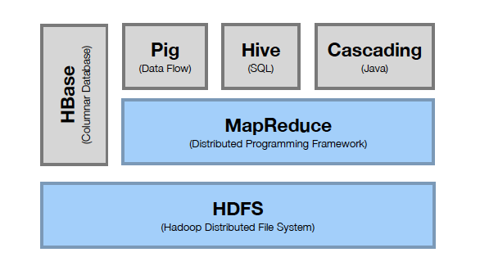
Hadoop Stack (Simplified)
Computation
Storage

Slide 21

What do we Mean by Hadoop
A framework for performing big data analytics
An implementation of the MapReduce paradigm
Hadoop glues the storage and analytics together and provides reliability, scalability, and management
Two Main Components
Storage (Big Data)
HDFS – Hadoop Distributed File System
Reliable, redundant, distributed file system optimized for large files
MapReduce (Computation)
Programming model for processing sets of data
Mapping inputs to outputs and reducing the output of multiple Mappers to one (or a few) answer(s)
Notes:
So what exactly is Hadoop anyway?
The quick answer is that Hadoop is a framework for performing Big Data Analytics, and as such is an implementation of the MapReduce programming model.
Hadoop is comprised of two main components, HDFS for storing big data and MapReduce for big data analytics.
The storage function consists of HDFS (Hadoop Distributed File System) that provides a reliable, redundant, distributed file system optimized for large files.
The analytics functions are provided by MapReduce that consists of a Java API as well as software to implement the services that Hadoop needs to function.
Hadoop glues the storage and analytics together in a framework that provides reliability, scalability, and management of the data.

Slide 22
Design principles of Hadoop
New way of storing and processing the data:
Let system handle most of the issues automatically:
Failures
Scalability
Reduce communications
Distribute data and processing power to where the data is
Make parallelism part of operating system
Relatively inexpensive hardware ($2 – 4K)
Bring processing to Data!
Hadoop = HDFS + MapReduce infrastructure
Optimized to handle
Massive amounts of data through parallelism
A variety of data (structured, unstructured, semi-structured)
Using inexpensive commodity hardware
Reliability provided through replication
Notes:
Distributed data, and distributed computing

Slide 23
Hadoop is not for all types of work
Not to process transactions (random access)
Not good when work cannot be parallelized
Not good for low latency data access
Not good for processing lots of small files
Not good for intensive calculations with little data
Notes:
Hadoop is not the silver bullet to solve all data-related problems. It’s being designed to handle big data. Hadoop works better when handling one single huge file than many small files. Hadoop complements existing RDBMS technology
Not good for low latency data access:
Wikipedia: “Low latency allows human-unnoticeable delays between an input being processed and the corresponding output providing real time characteristics. This can be especially important for internet connections utilizing services such as online gaming and VOIP. “ Replace “latency” with “delay”. So Low latency means negligible delay in processing. Low latency data access means, negligible delay accessing data. So hadoop is not for this. Hadoop works best with very large files. The larger the file, the less time Hadoop spends seeking for the next data location on disk and the more time Hadoop runs at the limit of the bandwidth of your disks. Seeks are generally expensive operations that are useful when you only need to analyze a small subset of your dataset. Since Hadoop is designed to run over your entire dataset, it is best to minimize seeks by using large files.
Hadoop is good for applications requiring high throughput of data: Clustered machines can read data in parallel for high throughput

Slide 24
Hadoop Operational Modes
Java MapReduce Mode
Write Mapper, Combiner, Reducer functions in Java using Hadoop Java APIs
Read records one at a time
Streaming Mode
Uses pipes and standard input and output streams
Any language (Python, Ruby, C, Perl, Tcl/Tk, etc.)
Input can be a line at a time, or a stream at a time
Notes:
Hadoop provides two operational modes, where each mode supports a type of interaction with MapReduce and HDFS. Since Hadoop is written in Java and provides Java classes and APIs to access them, Java MapReduce mode writes the mapper, combiner and reducer functions in Java. In the Java MapReduce mode, input data is made available to each function a record at a time.
In contrast, streaming mode supports standard *nix streams (stdin, stdout) and the *nix pipe mechanisms. This means that all the MapReduce functions can be written in any programming or scripting language you desire (C, Ruby, Python, Perl, etc.) Although input can be read a line at a time, some languages support the “slurping” of the entire input stream into memory (Perl is one example).

Slide 25
What is MapReduce?
A parallel programming model suitable for big data processing
Split data into distributable chunks (“shards”)
Define the steps to process those chunks
Run that process in parallel on the chunks
Scalable by adding more machines to process chunks
Leverage commodity hardware to tackle big jobs
The foundation for Hadoop
MapReduce is a parallel programming model
Hadoop is a concrete platform that implements MapReduce
Notes:
As we’ve said, the idea of MapReduce isn’t new (more like old wine in new bottles). What is new in Google’s MapReduce is the parallel processing of data as well as computation.
Here, a set of worker tasks each work on a subset of data where each subset is (usually) physically and logically distinct one from the other.
In the world of databases, this separation is often called “sharding.” Sharding is a technique whereby data is partitioned such that i/o operations can proceed without concern for other users, nor will these queries conflict with other users such that the data must be locked.
A classic example of this is separating a database into country of origin: queries against the US, Canada and Mexico run independently. The difference is that it’s the data that’s distributed as well as the computation.
MapReduce also borrows some elements of functional programming. All data elements in MapReduce are immutable; changing an input (key, value) pair does not change the input files. All communication occurs by generating new output (key, value) pairs and then forwarding the output to a new phase. At base, MapReduce programs transform lists of input data elements into lists of output data element, and do so twice: Once for the Map and once for the Reduce.

Slide 26
Philosophy to Scale for Big Data? (Divide and Conquer)
Divide Work
Map
“worker”
Reduce
Combine Results

Slide 27
When to Use MapReduce
Problems that are “embarrassingly parallel”
Examples
Word count
Reverse index
tf-idf
Distributed grep and distributed object recognition ("Where's Waldo?")
Distributed "associative" aggregation (marginalization, sum; mean if you track both numerator and denominator; min or max; count)
Hadoop calls them "combiners"
27
Notes:
For which kinds of problems is MapReduce most suited? Very simply, problems that are “embarrassingly parallel.“ In these situations, the problem can be decomposed into tasks that can be broken into “chunks” that can be distributed, processed, and recombined without communicating with each other.
Examples of such problems are listed on the slide. We’ve met some of these functions before: reverse index, tf-idf, distributed grep (pattern matching).
Marginalization occurs when you use aggregate statistics over certain variables as a way of reducing the number of variables in an analysis by focusing on the aggregation of other variables.
Consider this example.
Assume we have a table where each object has attributes "state", “climate" (wet, dry, temperate), and "% of cats in the US“ (pct_cats). This table provides us with the number of cats broken out by climate and state. If we sum the pct_cats across each state, then we are calculating the marginal probability of cats in each state. If we sum pct_cats across each value of climate, we are calculating the marginal probability of cats as a function of climate.
In statistical terms, the table gives you P(cats | state, climate). Marginalization is thus to aggregate this table up to either P(cats | state), or P(cats | climate), depending. For the SQL inclined, the statement
SELECT SUM(pct_cats) from table GROUP BY state;
would perform this action for the values of state.

Slide 28
MapReduce Examples
Word Count
Color Count
Joining Tables
Max yearly temperature

Slide 29
MapReduce Example: Word Count
Input
Split
Map
Shuttle/Sort
Reduce
Output
Deer, 1
Beer, 1
River, 1
Beer, 1
Beer, 1
Beer, 2
Dear Beer River
Beer, 2
Car, 3
Deer, 2
River, 2
Deer Beer River
Car Car River
Deer Car Beer
Car Car River
Car, 1
Car, 1
River, 1
Car, 1
Car, 1
Car, 1
Car, 3
Deer Car Beer
Deer, 1
Car, 1
Beer, 1
Deer, 1
Deer, 1
Deer, 2
River, 1
River, 1
River, 2
Q: What are the Key and Value Pairs of Map and Reduce?
Map: Key=word, Value=1
Reduce: Key=word, Value=aggregated count

Slide 30
MapReduce Example: Word Count
Input
Split
Map
Shuttle/Sort
Reduce
Output
Deer, 1
Beer, 1
River, 1
Beer, 1
Beer, 1
Beer, 2
Dear Beer River
Beer, 2
Car, 3
Deer, 2
River, 2
Deer Beer River
Car Car River
Deer Car Beer
Car Car River
Car, 1
Car, 1
River, 1
Car, 1
Car, 1
Car, 1
Car, 3
Deer Car Beer
Deer, 1
Car, 1
Beer, 1
Deer, 1
Deer, 1
Deer, 2
River, 1
River, 1
River, 2
Q: Do you see any place we can improve the efficiency?
Local aggregation at mapper will be able to improve MapReduce efficiency.

Slide 31
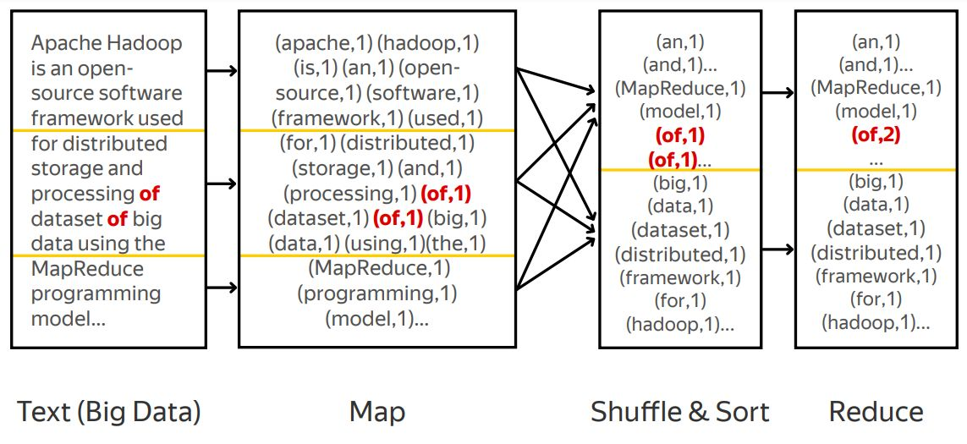
MapReduce Example: Word Count

Slide 32
MapReduce: Combiner
Combiner: do local aggregation/combine task at mapper
Q: What are the benefits of using combiner:
Reduce memory/disk requirement of Map tasks
Reduce network traffic
Q: Can we remove the reduce function?
No, reducer still needs to process records with same key but from different mappers
Q: How would you implement combiner?
It is the same as Reducer!
Car, 1
Car, 1
River, 1
Car, 2
River, 1
Car, 2
Car, 1
Car, 3

Slide 33
MapReduce – Map Phase
Mappers
Small program (typically), distributed across the cluster, local to data
Handle a portion of the input data (called a split)
Each mapper parses, filters, or transforms its input
Produces grouped <key,value> pairs
Map Phase
1
map
sort
Logical Output File
1
101101001010010011100111111001010011101001010010110010010101001100010100101110101110101111011011010101101001010100101010101011100100110101110100
copy
merge
10110100101001001110011111100101001110100101001011001001
reduce
2
map
sort
To DFS
2
3
Logical Output File
3
map
sort
merge
10110100101001001110011111100101001110100101001011001001
reduce
4
To DFS
4
map
sort
Logical Input File
Notes:
On the previous slide I said something to the effect that "if you write your programs in a special way" the programs can be brought to the data. This special way is called MapReduce, and involves breaking your program down into two discrete parts: Map and Reduce.
A mapper is typically a relatively small program with a relatively simple task: it is responsible for reading a portion of the input data, interpreting, filtering or transforming the data as necessary and then finally producing a stream of <key, value> pairs. What these keys and values are doesn't really matter for this discussion, but just keep in mind that these don't have to be simple values. They can be as big and complex as you need.
As shown in the diagram, the MapReduce environment will automatically take care of taking your small "map" program (the blue boxes) and pushing that program out to every machine that has a block of the file you are trying to process. This means that the bigger the file, the bigger the cluster, the more mappers get involved in processing the data! That's a pretty powerful idea.

Slide 34
MapReduce – The Shuffle
The output of each mapper is locally grouped together by key
One node is chosen to process data for each unique key
All of this movement (shuffle) of data is transparently orchestrated by MapReduce
Shuffle
1
map
sort
Logical Output File
1
101101001010010011100111111001010011101001010010110010010101001100010100101110101110101111011011010101101001010100101010101011100100110101110100
copy
merge
10110100101001001110011111100101001110100101001011001001
reduce
2
map
sort
To DFS
2
3
Logical Output File
3
map
sort
merge
10110100101001001110011111100101001110100101001011001001
reduce
4
To DFS
4
map
sort
Notes:
This next step is called "The Shuffle" and is orchestrated behind the scenes by MapReduce.
The idea here is that all of the data that is being emitted from the mappers is first locally grouped by the <key> that your program chose, and then for each unique key, a node is chosen to process all of the values from all of the mappers for that key.
For example, let say you used U.S. state (e.g. "MA", "AK", "NY", "CA", etc.) as the key of your data, then one machine would be chosen to send all of the California data to, one all of the New York data, and so on. Each machine would be responsible for processing the data for its selected state. In the picture above, the data clearly only had two keys (yellow and purple), but keep in mind that there may be many many records with the same key coming from a given mapper.

Slide 35
MapReduce – Reduce Phase
Reducers
Small programs (typically) that aggregate all of the values for the key that they are responsible for
Each reducer writes output to its own file
Reduce Phase
1
map
sort
Logical Output File
1
101101001010010011100111111001010011101001010010110010010101001100010100101110101110101111011011010101101001010100101010101011100100110101110100
copy
merge
10110100101001001110011111100101001110100101001011001001
reduce
2
map
sort
To DFS
2
3
Logical Output File
3
map
sort
merge
10110100101001001110011111100101001110100101001011001001
reduce
4
To DFS
4
map
sort
Notes:
Reducers are the last part of the picture. Again, these are small programs (well, typically small) that are responsible for sorting and/or aggregating all of the values with the key that is was assigned to work on. Just like with mappers, the more unique keys you have the more parallelism.
Once each reducer has completed whatever is assigned to do – maybe add up the total sales for the state it was assigned – it, in turn, emits key/value pairs that get written to storage that can, in turn, be used as the input to the next MapReduce job.
In an extremely over-simplified nutshell, that is MapReduce. So, what does this have to do with Jaql?

Slide 36
Word Count Example
In this example we have a list of animal names
MapReduce can automatically split files on line breaks
Our file has been split into two blocks on two nodes
We want to count how often each big cat is mentioned. In SQL that would be:
SELECT COUNT(NAME) FROM ANIMALS
WHERE NAME IN (Tiger, Lion …)
GROUP BY NAME;
Node 1
Node 2
Tiger
Lion
Lion
Panther
Wolf
…
Tiger
Tiger
Wolf
Panther
…
Notes:
36
From Wikipedia on MapReduce (http://en.wikipedia.org/wiki/MapReduce):
MapReduce is a framework for processing huge datasets on certain kinds of distributable problems using a large number of computers (nodes), collectively referred to as a cluster (if all nodes use the same hardware) or as a grid (if the nodes use different hardware). Computational processing can occur on data stored either in a file system (unstructured) or within a database (structured).
"Map" step: The master node takes the input, chops it up into smaller sub-problems, and distributes those to worker nodes. A worker node may do this again in turn, leading to a multi-level tree structure. The worker node processes that smaller problem, and passes the answer back to its master node.
"Reduce" step: The master node then takes the answers to all the sub-problems and combines them in some way to get the output - the answer to the problem it was originally trying to solve.

Slide 37
Map Input
Map Tasks need Key and Value pairs as input
If no key is available it needs to be fabricated
The mapping from input (files, web link, … ) to
<key, value> pairs is done in the InputFormat class
Node 1
Node 2
<Tiger, Tiger>
<Lion, Lion>
<Lion, Lion>
<Panther, Panther>
<Wolf, Wolf>
…
<Tiger, Tiger>
<Tiger, Tiger>
<Wolf, Wolf>
<Panther, Panther>
…
Notes:
37
From Wikipedia on MapReduce (http://en.wikipedia.org/wiki/MapReduce):
MapReduce is a framework for processing huge datasets on certain kinds of distributable problems using a large number of computers (nodes), collectively referred to as a cluster (if all nodes use the same hardware) or as a grid (if the nodes use different hardware). Computational processing can occur on data stored either in a file system (unstructured) or within a database (structured).
"Map" step: The master node takes the input, chops it up into smaller sub-problems, and distributes those to worker nodes. A worker node may do this again in turn, leading to a multi-level tree structure. The worker node processes that smaller problem, and passes the answer back to its master node.
"Reduce" step: The master node then takes the answers to all the sub-problems and combines them in some way to get the output - the answer to the problem it was originally trying to solve.

Slide 38
Map Task
We have two tasks in our map task
Filter non big cat rows
Prepare count by transforming to
<Text(name), Integer(1)>
Node 1
Node 1
Node 1
<Tiger, Tiger>
<Lion, Lion>
<Lion, Lion>
<Panther, Panther>
<Wolf, Wolf>
…
<Tiger, 1>
<Lion, 1>
<Lion, 1>
<Panther, 1>
…
<Tiger, 1>
<Lion, 1>
<Lion, 1>
<Panther, 1>
…
Node 2
Node 2
Node 2
<Tiger, Tiger>
<Tiger, Tiger>
<Wolf, Wolf>
<Panther, Panther>
…
<Tiger, 1>
<Tiger,1>
<Panther, 1>
…
<Tiger, 1>
<Tiger,1>
<Panther, 1>
…
Map Tasks are executed locally on each split
Notes:
38
From Wikipedia on MapReduce (http://en.wikipedia.org/wiki/MapReduce):
MapReduce is a framework for processing huge datasets on certain kinds of distributable problems using a large number of computers (nodes), collectively referred to as a cluster (if all nodes use the same hardware) or as a grid (if the nodes use different hardware). Computational processing can occur on data stored either in a file system (unstructured) or within a database (structured).
"Map" step: The master node takes the input, chops it up into smaller sub-problems, and distributes those to worker nodes. A worker node may do this again in turn, leading to a multi-level tree structure. The worker node processes that smaller problem, and passes the answer back to its master node.
"Reduce" step: The master node then takes the answers to all the sub-problems and combines them in some way to get the output - the answer to the problem it was originally trying to solve.

Slide 39
Shuffle
Shuffle moves all values of one key to the same target node
Distribution is done through a Partitioner Class (normally hash distribution)
Reduce Tasks can run on arbitrary nodes, in our example Node 1 and 3
The number of Map and Reduce tasks do not need to be identical
Differences are handled by hash partitioner
Node 1
Node 1
Node 1
<Tiger, 1>
<Lion, 1>
<Lion, 1>
<Panther, 1>
…
<Tiger, 1>
<Lion, 1>
<Lion, 1>
<Panther, 1>
…
<Panther, <1,1>>
<Tiger, <1,1,1>>
…
Node 2
Node 2
Node 3
<Tiger, 1>
<Tiger,1>
<Panther, 1>
…
<Tiger, 1>
<Tiger,1>
<Panther, 1>
…
<Lion, <1,1>>
…
Shuffle task distributes keys using Hash partitioner. Results are stored in HDFS blocks on the machines that run the Reduce jobs
Notes:
39
From Wikipedia on MapReduce (http://en.wikipedia.org/wiki/MapReduce):
MapReduce is a framework for processing huge datasets on certain kinds of distributable problems using a large number of computers (nodes), collectively referred to as a cluster (if all nodes use the same hardware) or as a grid (if the nodes use different hardware). Computational processing can occur on data stored either in a file system (unstructured) or within a database (structured).
"Map" step: The master node takes the input, chops it up into smaller sub-problems, and distributes those to worker nodes. A worker node may do this again in turn, leading to a multi-level tree structure. The worker node processes that smaller problem, and passes the answer back to its master node.
"Reduce" step: The master node then takes the answers to all the sub-problems and combines them in some way to get the output - the answer to the problem it was originally trying to solve.

Slide 40
Persisting Data in Shuffle
Data is persisted in DFS in Shuffle phase
Allows Map and Reduce tasks to be restarted
Multiple Map outputs need to be merged into a single Reducer Input
Merging is done in Memory
Regularly persisted in DFS
Sort memory for merge can be configured
Using a merge sort operation of the various input files
Notes:
40
From Wikipedia on MapReduce (http://en.wikipedia.org/wiki/MapReduce):
MapReduce is a framework for processing huge datasets on certain kinds of distributable problems using a large number of computers (nodes), collectively referred to as a cluster (if all nodes use the same hardware) or as a grid (if the nodes use different hardware). Computational processing can occur on data stored either in a file system (unstructured) or within a database (structured).
"Map" step: The master node takes the input, chops it up into smaller sub-problems, and distributes those to worker nodes. A worker node may do this again in turn, leading to a multi-level tree structure. The worker node processes that smaller problem, and passes the answer back to its master node.
"Reduce" step: The master node then takes the answers to all the sub-problems and combines them in some way to get the output - the answer to the problem it was originally trying to solve.

Slide 41
Reduce
The reduce task computes aggregated values for each key
Normally the output is written to DFS
By default: one output part file per Reduce task
Node 1
Node 1
Node 1
<Tiger, 1,1,1>
<Panther, 1,1>
…
<Panther, 2>
<Tiger, 3>
…
<Panther, <1,1>>
<Tiger, <1,1,1>>
…
Node 3
Node 3
Node 3
<Lion, 1,1>
…
<Lion, 2>
…
<Lion, <1,1>>
…
Reduce tasks aggregate all values of a specific key. In our case a count on the number arrays
41
Notes:
41
From Wikipedia on MapReduce (http://en.wikipedia.org/wiki/MapReduce):
MapReduce is a framework for processing huge datasets on certain kinds of distributable problems using a large number of computers (nodes), collectively referred to as a cluster (if all nodes use the same hardware) or as a grid (if the nodes use different hardware). Computational processing can occur on data stored either in a file system (unstructured) or within a database (structured).
"Map" step: The master node takes the input, chops it up into smaller sub-problems, and distributes those to worker nodes. A worker node may do this again in turn, leading to a multi-level tree structure. The worker node processes that smaller problem, and passes the answer back to its master node.
"Reduce" step: The master node then takes the answers to all the sub-problems and combines them in some way to get the output - the answer to the problem it was originally trying to solve.

Slide 42
Optional: Combiner
For performance reasons a local Aggregate in the Map task can be helpful
Reduces the amount of data that needs to be copied over the network
Also reduces Merge effort
After Map task and before Shuffle
Node 1
Node 1
<Tiger, 1>
<Lion, 1>
<Lion, 1>
<Panther, 1>
…
<Tiger, 1>
<Lion, 2>
<Panther, 1>
…
Node 2
Node 2
<Tiger, 1>
<Tiger,1>
<Panther, 1>
…
<Tiger, 2>
<Panther, 1>
…
Combiner creates local aggregates on each Map Node, reduces the amount of data that needs to be copied over the network
42
Notes:
42
From Wikipedia on MapReduce (http://en.wikipedia.org/wiki/MapReduce):
MapReduce is a framework for processing huge datasets on certain kinds of distributable problems using a large number of computers (nodes), collectively referred to as a cluster (if all nodes use the same hardware) or as a grid (if the nodes use different hardware). Computational processing can occur on data stored either in a file system (unstructured) or within a database (structured).
"Map" step: The master node takes the input, chops it up into smaller sub-problems, and distributes those to worker nodes. A worker node may do this again in turn, leading to a multi-level tree structure. The worker node processes that smaller problem, and passes the answer back to its master node.
"Reduce" step: The master node then takes the answers to all the sub-problems and combines them in some way to get the output - the answer to the problem it was originally trying to solve.

Slide 43
Example 2: Color Count
Job: Count the number of each color in a data set
Input blocks on HDFS
Produces (k, v)
( , 1)
Shuffle & Sorting based on k
Consumes(k, [v])
( , [1,1,1,1,1,1..])
Produces(k’, v’)
( , 100)
Part0001
Part0002
Part0003
That’s the output file, it has 3 parts on probably 3 different machines

Slide 44
Joining Data
Task: combine datasets by key A standard data management function
In pseudo SQL
Select * from table A, table B, where A.key=B.key
Joins can be inner, left or right outer

Slide 45
Joining Data – Cont.
Task: given two wordcount datasets …
File A: <word, total-count>
File B: <date word, day-count>
able , 5
actor , 18
burger , 25
.
.
.
Jan-16 able , 2
Feb-22 actor , 15
April-15 actor , 2
Jul-4 burger, 20
May-03 actor , 1
.
.
.

Slide 46
Joining Data – Cont.
Task: combine by word
Result wanted
File A join B: <word date, day-count total-count >
able Jan-16, 2 5
actor Feb-22, 15 18
actor April-15, 2 18
burger Jul-04, 20 25
actor May-03, 1 18
.
.
.

Slide 47
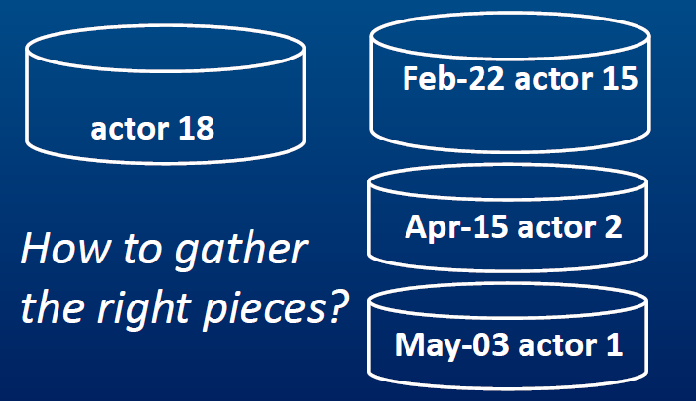
Joining Data – Cont.
Recall that data is split in parts

Slide 48
Key-Value & Task Decomposition
Main design consideration:
Join depends on word
(e.g. Select * where A.word=B.word)
For the join:
Let <key> = word
Let <value> = other info
<word, … >

Slide 49
Key-Value & Task Decomposition
File A: <word, total-count>
File B: <date word, day-count>
able , 5
actor , 18
Jan-16 able , 2
Feb-22 actor , 15
April-15 actor , 2
May-03 actor, 1
File B_new: <word, date day-count>
able , 5
actor , 18
able , Jan-16 2
actor , Feb-22 15
actor , April-15 2
actor, May-03 1
Now data sets are formed into <key, Value>

Slide 50
Shuffle and Group By Hadoop
actor , 18
actor , Feb-22 15
actor , April-15 2
actor, May-03 1
actor , Feb-22 15
actor , 18
actor , April-15 2
actor, May-03 1

Slide 51
Reduce
Reducer now has all the data for same word grouped together
Reducer can now join the data and put date back into key
actor , Feb-22 15
actor , 18
actor , April-15 2
actor, May-03 1
Feb-22 actor, 15 18
May-03 actor , 3 18

Slide 52


MapReduce Summary
Hadoop computation model
Data stored in a distributed file system spanning many inexpensive computers
Bring function to the data
Distribute application to the compute resources where the data is stored
Scalable to thousands of nodes and petabytes of data
public static class TokenizerMapper
extends Mapper<Object,Text,Text,IntWritable> {
private final static IntWritable
one = new IntWritable(1);
private Text word = new Text();
public void map(Object key, Text val, Context
StringTokenizer itr =
new StringTokenizer(val.toString());
while (itr.hasMoreTokens()) {
word.set(itr.nextToken());
context.write(word, one);
}
}
}
public static class IntSumReducer
extends Reducer<Text,IntWritable,Text,IntWrita
private IntWritable result = new IntWritable();
public void reduce(Text key,
Iterable<IntWritable> val, Context context){
int sum = 0;
for (IntWritable v : val) {
sum += v.get();
. . .
Hadoop Data Nodes
Map Phase (break job into small parts)
Shuffle (transfer interim output for final processing)
Reduce Phase (boil all output down to a single result set)
Distribute map tasks to cluster
MapReduce Application
Shuffle
Result Set
Return a single result set
Notes:
There are two aspects of Hadoop that are important to understand:
MapReduce is a software framework introduced by Google to support distributed computing on large data sets of clusters of computers.
The Hadoop Distributed File System (HDFS) is where Hadoop stores its data. This file system spans all the nodes in a cluster. Effectively, HDFS links together the data that resides on many local nodes, making the data part of one big file system. Furthermore, HDFS assumes nodes will fail, so it replicates a given chunk of data across multiple nodes to achieve reliability. The degree of replication can be customized by the Hadoop administrator or programmer. However, by default is to replicate every chunk of data across 3 nodes: 2 on the same rack, and 1 on a different rack.
The key to understanding Hadoop lies in the MapReduce programming model. This is essentially a representation of the divide and conquer processing model, where your input is split into many small pieces (the map step), and the Hadoop nodes process these pieces in parallel. Once these pieces are processed, the results are distilled (in the reduce step) down to a single answer.

Slide 53
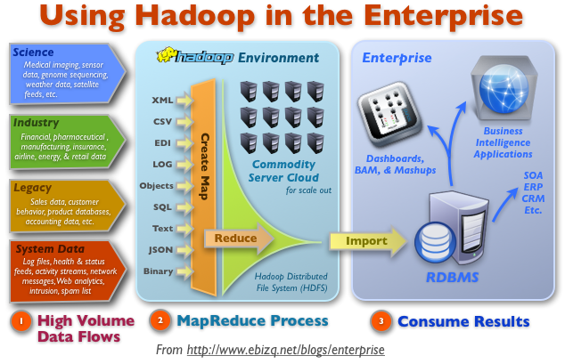
Hadoop in Bigger Enterprises

Slide 54
A Weather Dataset
Data from the National Climatic Data Center (NCDC). https://www.ncdc.noaa.gov/data-access
ftp://ftp.ncdc.noaa.gov/pub/data/noaa/
Stored using a line-oriented ASCII format, in which each line is a record.
Files are grouped by year
Fields are packed into one line with no delimiters.
0029029070999991901010106004+64333+023450FM-12+000599999V0202701N015919999999N0000001N9-00781
+99999102001ADDGF108991999999999999999999
0029029070999991901010113004+64333+023450FM-12+000599999V0202901N008219999999N0000001N9-00721+99999102001ADDGF104991999999999999999999

Slide 55
Format of a National Climatic Data Center record
0057
332130 # USAF weather station identifier
99999 # WBAN weather station identifier
19500101 # observation date
0300 # observation time
4
+51317 # latitude (degrees x 1000)
+028783 # longitude (degrees x 1000)
FM-12
+0171 # elevation (meters)
99999
V020
320 # wind direction (degrees)
1 # quality code
N
0072
1
00450 # sky ceiling height (meters)
1 # quality code
C
N
010000 # visibility distance (meters)
1 # quality code
N
9
-0128 # air temperature (degrees Celsius x 10)
1 # quality code
-0139 # dew point temperature (degrees Celsius x 10)
1 # quality code
10268 # atmospheric pressure (hectopascals x 10)
1 # quality code

Slide 56
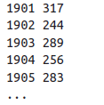
Weather Data Insights
SID max
317
289
283
What’s the highest recorded temperature for each station?
What’s the highest recorded global temperature for each year?
What’s the highest recorded global temperature for each hour?
For each station, at what hour the max temperature occurred?

Slide 57
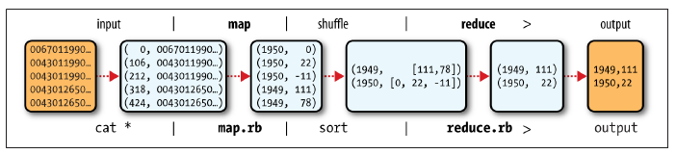
Analyzing the Data with Hadoop
Map Reduce
Hadoop Streaming
The keys are the line offsets within the file, which we ignore in our map function.
The map function extracts the year and the air temperature and emits them as its output
the reduce function iterates through the list and pick up the maximum reading

Slide 58
Hadoop Streaming
Hadoop provides an API to MapReduce that allows you to write your map and reduce functions in languages other than Java.
Hadoop Streaming uses Unix standard streams as the interface between Hadoop and your program
Thus you can use any language that can read standard input and write to standard output to write your MapReduce program. (Python, Ruby)

Slide 59
Streaming is naturally suited for text processing
Map input data is passed over standard input to your map function, which processes it line by line and writes lines to standard output.
A map output key-value pair is written as a single tab-delimited line.
Input to the reduce function is in the same format—a tab-separated key-value pair—passed over standard input.
The reduce function reads lines from standard input, which the framework guarantees are sorted by key, and writes its results to standard output.

Slide 60
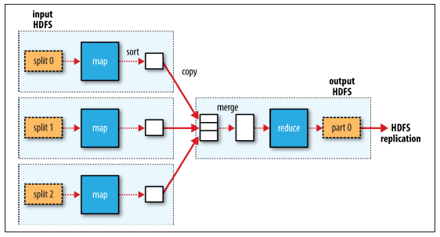
MapReduce data flow with a single reduce task

Slide 61
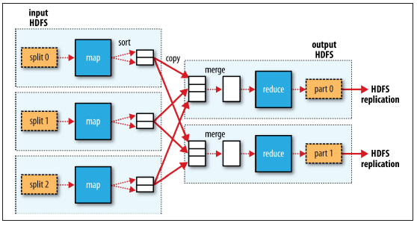
MapReduce data flow with multiple reduce tasks

